Slide 1
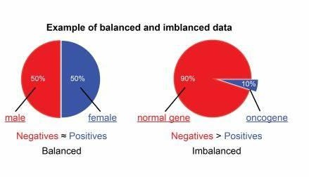

Imbalanced Dataset
Abu Bakar Siddique Mahi

Slide 2
Cross Validation
Cross-validation is a resampling procedure used to evaluate machine learning models on a limited data sample. It is a technique used to protect against overfitting in a predictive model, particularly in a case where the amount of data may be limited. In cross-validation, you make a fixed number of folds (or partitions) of the data, run the analysis on each fold, and then average the overall error estimate.

Slide 3
Cross Validation
Hold Out Cross Validation
K-Fold Cross Validation
Leave One-Out Cross Validation (LOOCV)
Stratified K Fold Cross Validation

Slide 4
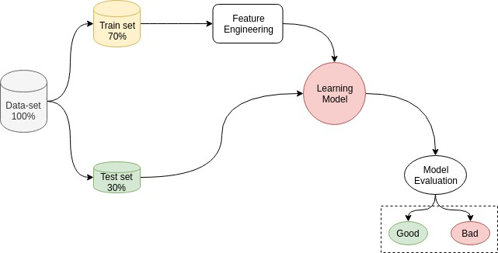
Machine Learning Model

Slide 5
Cross Validation
Hold Out Cross Validation
from sklearn.model_selection import train_test_split
xtrain, xtest, ytrain, ytest = train_test_split(x,y, train_size=0.7, random_state=1)

Slide 6
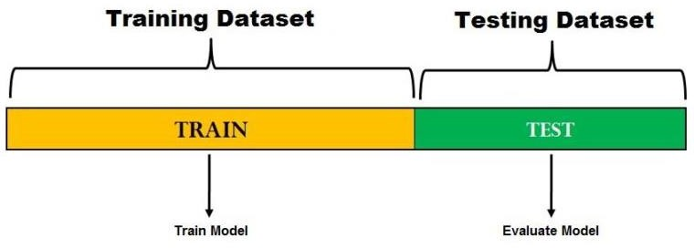
Cross Validation
Hold Out Cross Validation
Dataset
Train Model
Evaluate Model

Slide 7
Cross Validation
K-Folds Cross Validation
The general procedure is as follows:
Shuffle the dataset randomly.
Split the dataset into k groups
For each unique group:
Take the group as a hold out or test data set
Take the remaining groups as a training data set
Fit a model on the training set and evaluate it on the test set
Retain the evaluation score and discard the model
Summarize the skill of the model using the sample of model
evaluation scores

Slide 8
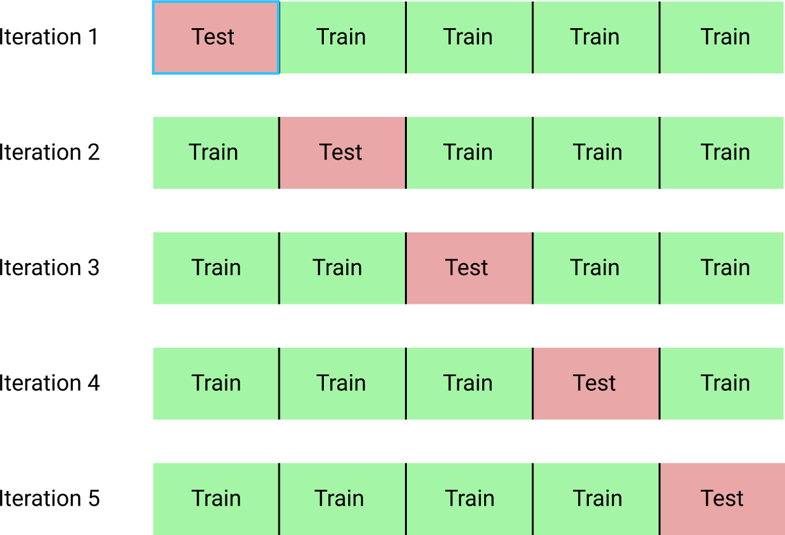
Cross Validation
K-Folds Cross Validation
The general procedure is as follows:
20% 20% 20% 20% 20%
Shuffle the dataset randomly.
Split the dataset into k groups
For each unique group:
Take the group as a hold out or test data set
Take the remaining groups as a training data set
Fit a model on the training set and evaluate it on the test set
Retain the evaluation score and discard the model
Summarize the skill of the model using the
sample of model evaluation scores

Slide 9
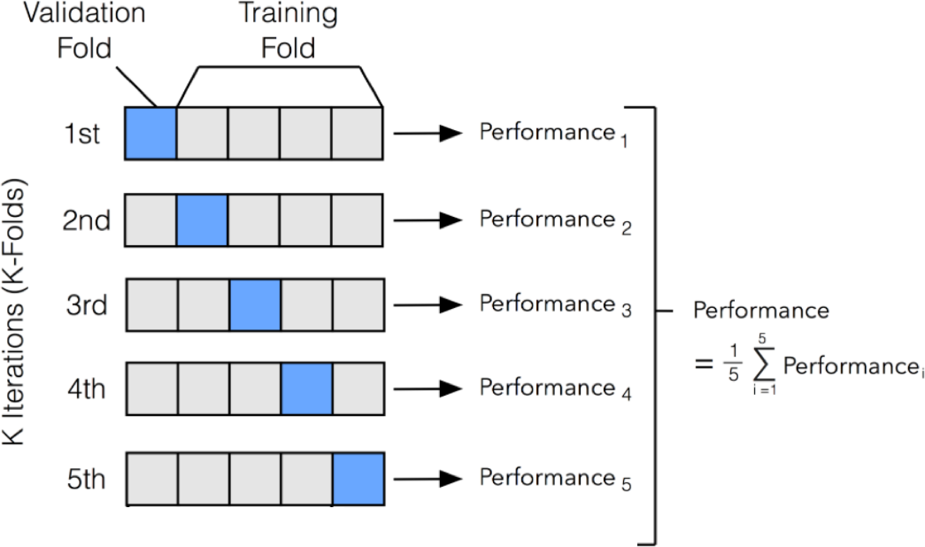
Cross Validation
K-Folds Cross Validation

Slide 10
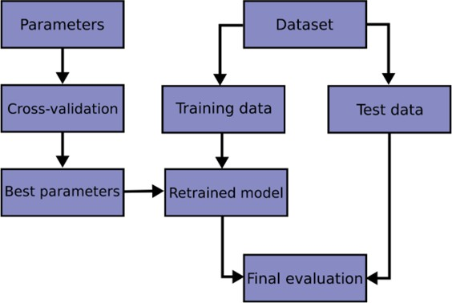
Cross Validation
Cross-validation is a resampling procedure used to evaluate machine learning models on
a limited data sample.
1
2
3
4
5
K = 5

Slide 11
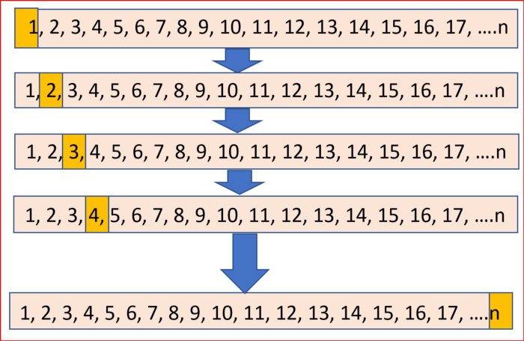
Cross Validation
Leave One-Out Cross Validation (LOOCV)
Leave One Out Cross Validation for N Samples

Slide 12
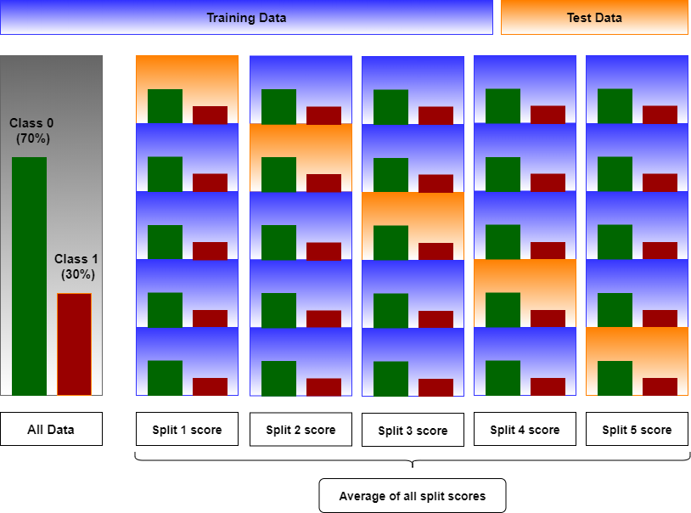
Cross Validation
Stratified K Fold Cross Validation

Slide 13
Cross Validation
Let’s Do it with PYTHON

